Slide 1
Parallel Mesh Management Using Interoperable Tools
International Meshing Roundtable Short Course
October 2010
Karen Devine, Sandia National Laboratories
Timothy Tautges, Argonne National Laboratory

Slide 2



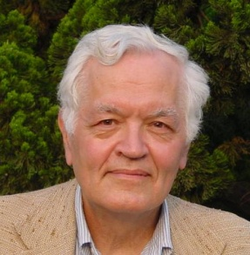

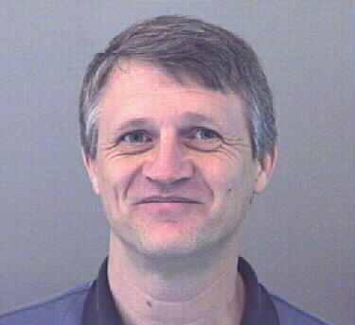




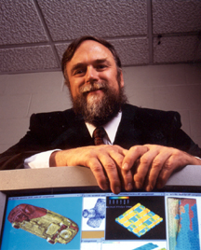


Thanks to the ITAPS team for contributions to this presentation.
Lori Diachin
LLNL
Ed d’Azevedo
ORNL
Karen Devine
SNL
Jim Glimm
BNL/SUNY SB
Ken Jansen
U. Colorado
Pat Knupp
SNL
Xiaolin Li
SUNY SB
Ahmed Khamayseh
ORNL
Roman Samulyak
BNL
Carl Ollivier-Gooch
UBC
Mark Shephard
RPI
Tim Tautges
ANL
Harold Trease
PNNL

Slide 3
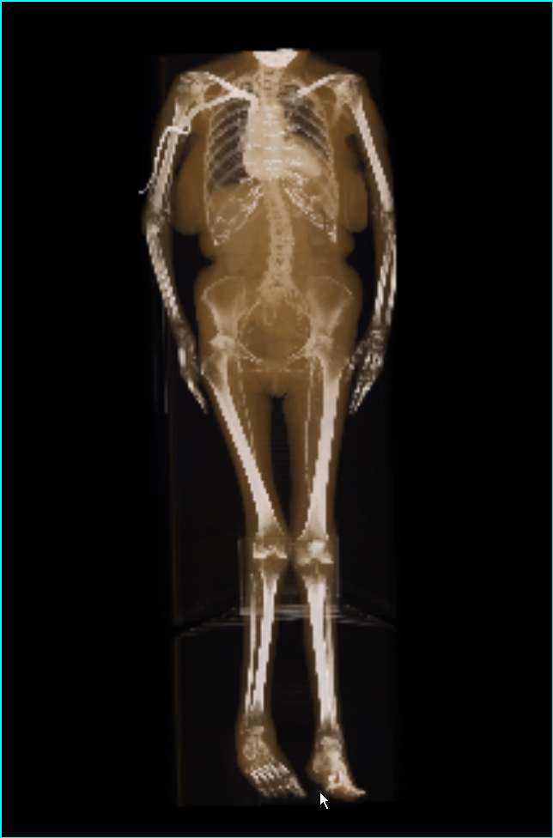
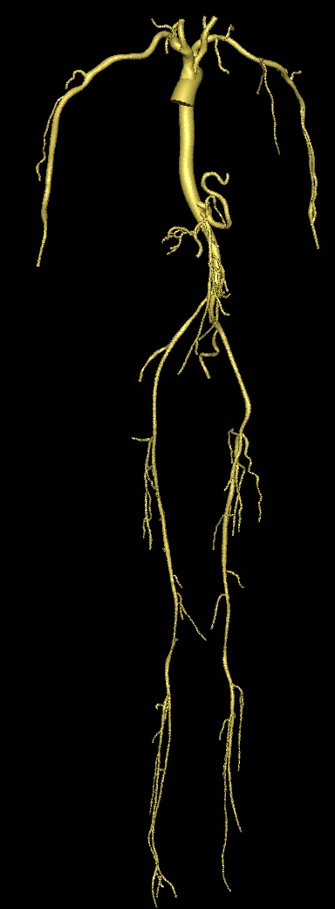
The reasons for parallelism in mesh-based research are growing.
Parallel computing is more pervasive than ever.
Leadership-class parallel computers
Medium-sized clusters
Small multicore desktop computers
Applications are interested in using larger meshes than ever.
O(100M)-O(1B) entities becoming common.
Mesh sizes are exceeding the available memory in single-node computers.
Vascular flow simulations can use 8B-element meshes on 294K processors.
--Courtesy of RPI, Stanford

Slide 4
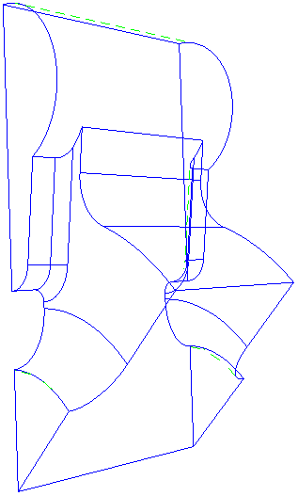
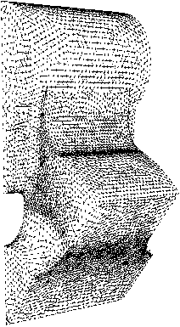
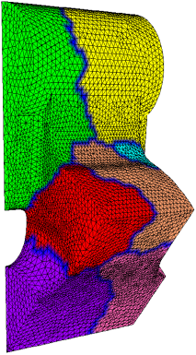
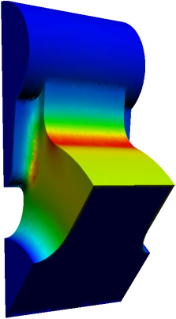
Parallel mesh management is needed by parallel mesh-based applications.
Construct or load the initial mesh (serial or parallel).
Improve the mesh using smoothing and swapping.
If necessary, (re)partition the mesh across processors.
Solve the PDE on mesh and estimate the error.
Requires access to entities and their adjacencies.
While error > tolerance,
Refine, coarsen, improve and repartition the mesh.
Solve the PDE on the mesh and estimate the error.
Store results for visualization and analysis.
Omega3P
S3P
T3P
Tau3P
CAD
Meshing
Partitioning
Solvers
Refinement
Notes:
Benefit of parallel mesh management for APPLICATIONS

Slide 5
Parallel mesh management benefits parallel mesh generation research.
Parallel mesh management tools provide infrastructure for parallel mesh creation and modification.
By adopting mesh management tools, parallel mesh generation researchers can focus on algorithm development, rather than details of infrastructure.

Slide 6
Careful software design broadens applicability and simplifies use.
Interoperable software:
Uses component approach to tool development.
Employs a common data model with well-defined interfaces.
Allows plug-and-play use and evaluation.
Provides a quick route to use in applications.
Benefits to mesh-generation community:
Allows straightforward use of existing mesh management tools.
Enables delivery of mesh-generation algorithms to potential users.
Notes:
To benefit research and application community…

Slide 7
Topics of this short course
Basic concepts of parallel mesh management
Software design for interoperability
The ITAPS project and its goals
The ITAPS parallel data model
ITAPS parallel mesh technologies
Applications using ITAPS tools

Slide 8
Basic Concepts of Parallel Mesh Management

Slide 9
Unstructured Meshes on Parallel Computers
Typically, meshes are distributed over independent memories.
A mesh partition groups mesh entities into subsets called parts.
Applications using a partitioned mesh need…
Communication links between “shared” mesh entities on neighboring parts.
Ability to move mesh entities between parts (while maintaining links).
Algorithms to maintain load balance of parts while minimizing communications.
Communication between processors of data associated with mesh entities.
partition boundary
P₂
P₀
0
M
i
M_{j}
P₁

Slide 10
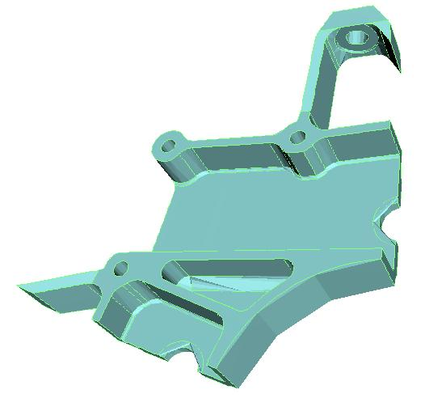
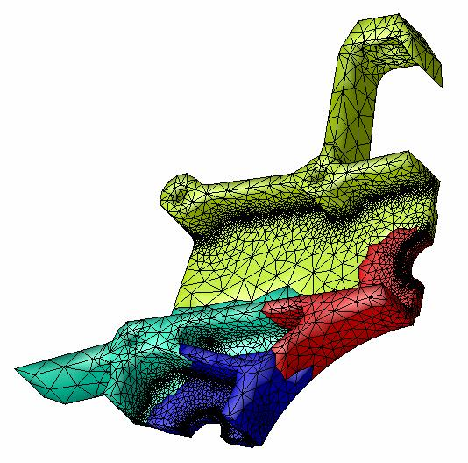
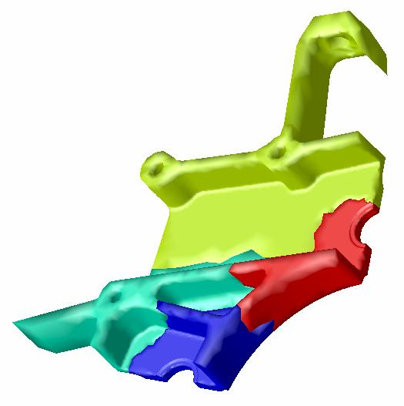
Conceptual view of an unstructured mesh partition model
Special mesh adjacency information represented in partition model:
Entities shared on part boundaries (used to define inter-part communication of shared entities)
Off-part entities adjacent to shared entities (used for ghosting to complete stencil or support)
Domain of Interest
Mesh distributed over four parts
Partition model focuses on mesh entities between parts.
Notes:
In addition to storing ents in parts, partition model maintains boundary info.

Slide 11
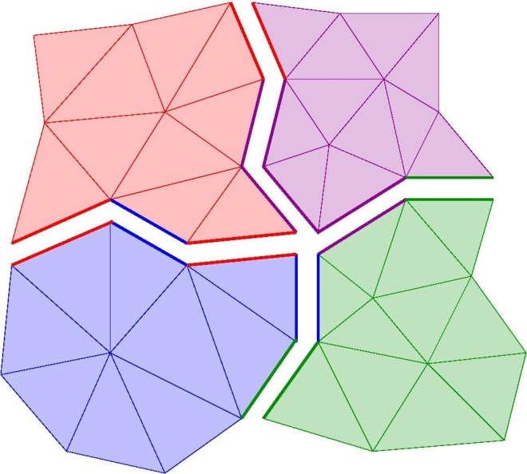
Distributed mesh representations have several functional requirements.
Entity ownership
Each mesh entity is owned by exactly one part.
Ownership imbues right to modify.
Ownership is not static during the course of a simulation.
Repartitioning
Local micro-migration
Some entities have read-only copies on other parts (e.g. along part boundaries and ghosts).
Communication links
Efficient mechanisms to update mesh partitioning and keep the links between parts are mandatory.
Solution data associated with shared entities must be communicated.
Notes:
Other features of partition model … assigning entity ownership and maintaining communication.

Slide 12
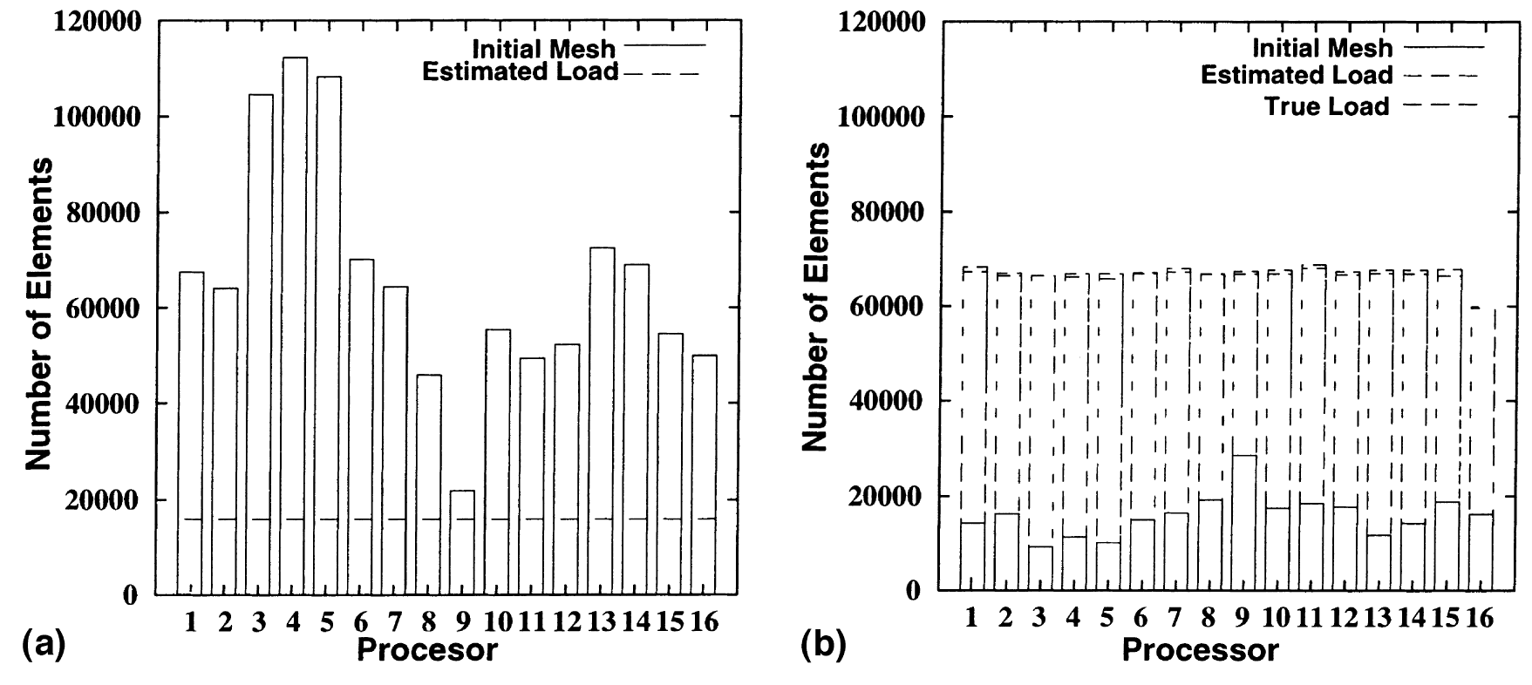
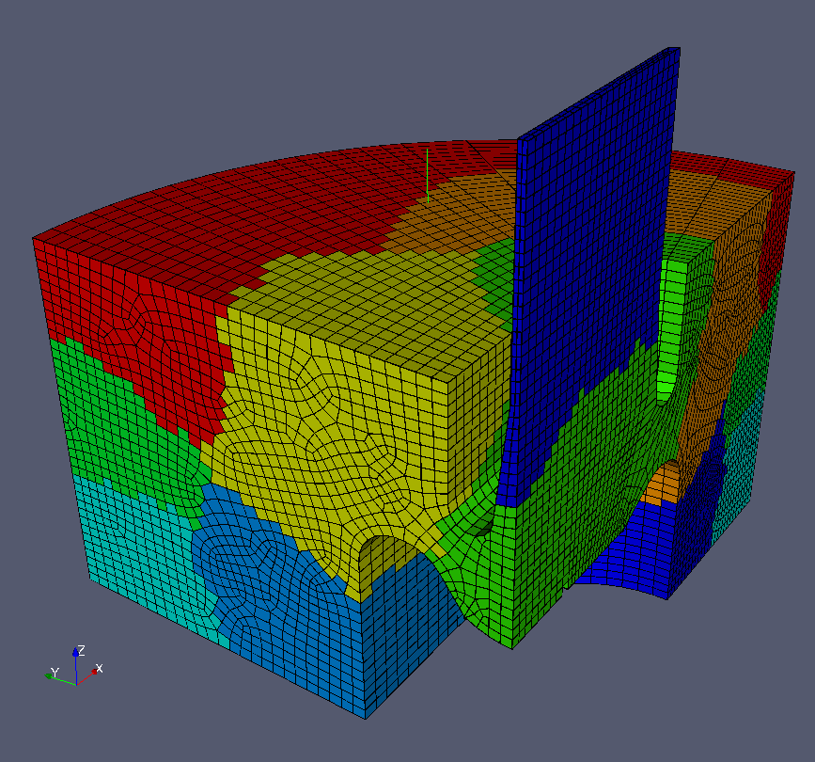
Key issues that must be addressed for parallel computation
Scalability
Load balance as the mesh changes
Low communication overhead costs
Efficient use of distributed memory
Function
Consistent, correct mesh operations
Management of complex communication schedules
Performance
Near optimal serial efficiency on each processor
Minimal overhead when using general tools relative to native implementations
Notes:
Scalability = computation + memory usage
Function = maintaining a consistent database in parallel.
Performance = serial efficiency + low software overhead for components.

Slide 13
Software Design for Interoperability

Slide 14
Complex simulations place greater requirements on software designers.
Constraints:
Wide variety of capabilities needed.
High performance required.
Development schedules are tight.
Mesh management is a large part of PDE-based simulations.
These constraints apply to mesh management as well as to the entire simulation.
What is the best approach for development of complex simulation and mesh-management software?

Slide 15
Software Development Options
One option: Implement everything yourself.
Key advantage: Total control.
Disadvantages:
Time and resource consuming.
Reinventing the wheel.
Development outside area of expertise.
Another option: Adopt a framework.
Key advantage: Many capabilities in one package.
Disadvantages:
Many capabilities in one package: all or nothing.
Require use of framework data structures.
Steep learning curve for application developers.
Limited flexibility.
Strong dependence on framework developers and their schedules.

Slide 16
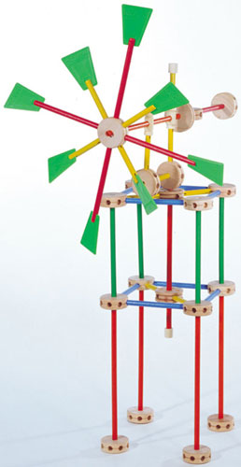
Component Design
Construct applications from smaller software “pieces.”
“Tinker-toy parallel computing” -- B. Hendrickson
Components provide …
Services applications commonly need.
Support for wide range of applications.
Easy-to-use interfaces.
Data abstraction.
Components avoid …
Prescribed data structures
Heavy framework
Limited freedom for application developers.
Hasbro, Inc.

Slide 17
Analysis Tools
(black-box)
Mesh Tools
Optimization
Mesh I/O
Parameter Studies
Mesh Generation
UQ (non-invasive)
Components for Sandia’s Rapid Development of Production Applications (A. Salinger et al., 2008)
Inline Meshing
V&V, Calibration
Load Balancing
OUU, Reliability
Adaptivity
Computational Steering
Remeshing
Analysis Tools
(embedded)
Grid Transfers
Mesh Quality
Nonlinear Solver
Time Integration
Mesh Database
Utilities
Continuation
Input File Parser
Sensitivity Analysis
Mesh Database
Parameter List
Stability Analysis
Geometry Database
Composite Physics
I/O Management
Constrained Solves
Solution Database
Memory Management
Optimization
MultiPhysics Coupling
Communicators
UQ Solver
Discretizations
Solution Control
Runtime Compiler
System Models
MultiCore
Parallelization Tools
Linear Algebra
Discretization Library
System UQ
Variable Manager
Data Structures
Physics Fill
Iterative Solvers
Derivative Tools
PostProcessing
Direct Solvers
Element Level Fill
UQ / PCE
Propagation
Material Models
Visualization
Eigen Solver
Preconditioners
Sensitivities
Objective Function
Embedded Verification
Matrix Partitioning
Derivatives
Constraints
Feature Extraction
Architecture-
Dependent Kernels
Adjoints
Error Estimates
Data Reduction
MMS Source Terms
Model Reduction
Notes:
1. allows both quick access to ready-for-prime-time mesh capability, and access to future improvements 2. component-based mesh tools are where solvers were 10 years ago; since then, component-based solvers have revolutionized parallel application development, mesh components will do the same eventually

Slide 18
Advantages of Component Design
For users:
Smaller learning curve than large framework.
Easy to add to existing applications.
“Expert” implementations instead of “roll-your-own.”
Enable comparisons of different algorithms and implementations.
Time and cost saving.
For developers:
Reduced dependencies between components eases effort of working in teams.
Separation of efforts for team members allows individual contribution with reduced conflicts.
Enable software reuse.
For all: Migration path to emerging architectures.
Multicore, Cell, GPU, etc.
Implement new algorithms in components; users get benefits “for free.”
Notes:
Roll-your-own: look up one alg, implement it, move on.

Slide 19
Components are connected via interfaces and data model.
Interfaces define how to access components’ functionality (inputs and outputs).
Classes (C++, Java), modules (F90)
Function prototypes (C, F77)
Interfaces do NOT specify how the underlying functionality is implemented.
Data structures, language, algorithm are chosen by the developer.
Data model describes the inputs and outputs of the interface.
E.g., entities, lists, sets, fields.
Shared interfaces and data models enable interoperability.
Enable plug-and-play use of different implementations of similar functionality.
Enable data sharing among components.

Slide 20
Mesh I/O Interface
Analysis Tools
(black-box)
Mesh Tools
Mesh File
Dakota Application Interface
Composite Physics
Utilities
Analysis Tools
(embedded)
ITAPS Interfaces
XML
Mesh Database
Input File
Trilinos’ Stratimikos
Model Evaluator
Local Fill
PostProcessing
Linear Algebra
Discretizations
Physics Fill
Rapid Development of Production Applications Interfaces between Components
Derivative Tools
Finite Element Interface
<Scalar>
Notes:
Rapid Development of Production Applications
Some standardized interfaces: FEI, XML, ITAPS interfaces
Some toolkit-specific interfaces: Dakota, ModelEvaluator

Slide 21
The ITAPS Project and its Goals

Slide 22
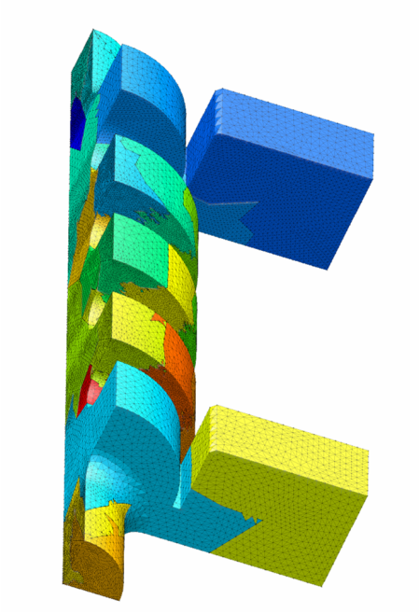
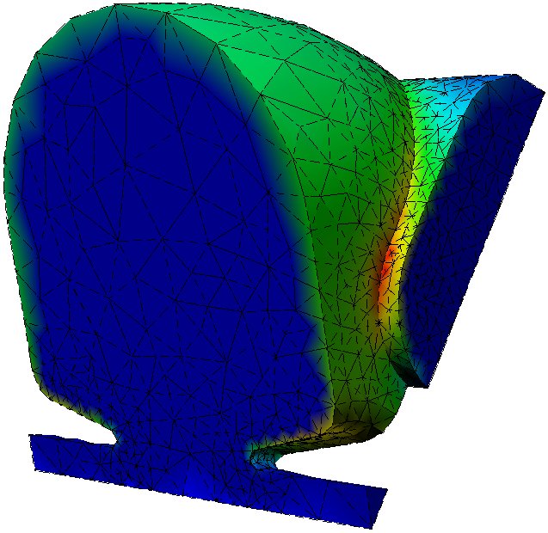
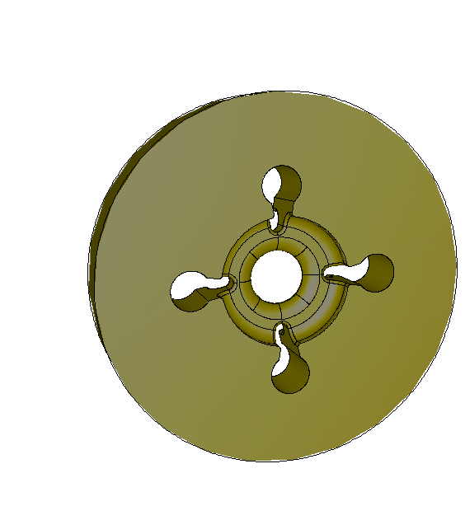
Interoperable Technologies for Advanced Petascale Simulations
DOE SciDAC Center (Scientific Discovery through Advanced Computing)
ITAPS Goals
Improve applications’ ability to take advantage of state-of-the-art meshing and geometry tools.
Develop the next generation of meshing and geometry tools for petascale computing.
Technology Focus Areas
Complex geometry
High quality meshes and adaptivity
Coupled phenomenon
Dynamic mesh calculations
Tera/Petascale computing

Slide 23
ITAPS uses a component-based approach to technology development.
Develop and deploy key mesh, geometry and field manipulation component services needed for petascale computing applications.
Develop advanced functionality integrated services to support application needs.
Combine component services together.
Unify tools with common interfaces and data model to enable interoperability.
Interfaces are implemented on top of existing mesh databases.
Petascale
Integrated
Tools
Build on
Component
Services
Are unified
by
Common
Interfaces

Slide 24
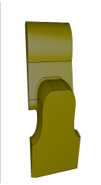
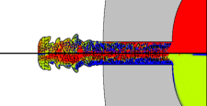
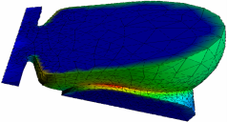
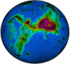
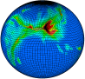
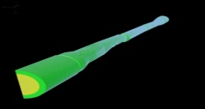
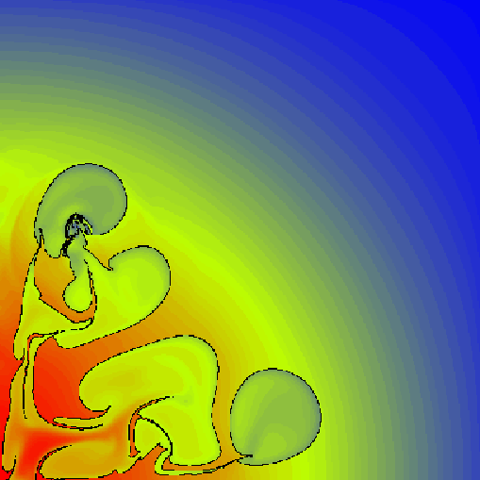
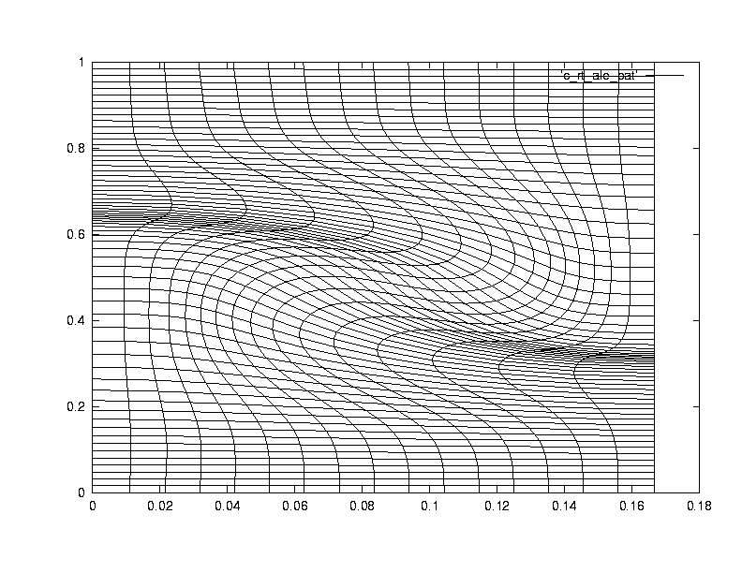
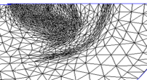
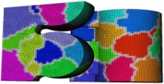
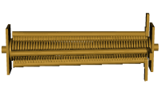
ITAPS Software Component Architecture
Petascale
Integrated
Tools
Build on
AMR
Front tracking
Shape
Optimization
Solution
Adaptive
Loop
Solution
Transfer
Petascale
Mesh
Generation
Component
Tools
Are unified
by
Front
tracking
Mesh
Improve
Mesh
Adapt
Swapping
Interpolation
Kernels
Dynamic
Services
Geom/Mesh
Services
Common
Interfaces
Mesh
Geometry
Relations
Field
to…
Mesh Databases
Geometry Databases
Solution Databases

Slide 25
The ITAPS interoperability goal requires abstracting the data model.
Information flows from geometric representation of the domain to the mesh to the solvers and post-processing tools.
Adaptivity and design optimization require loops.
The data model must encompass a broad spectrum of mesh types and usage scenarios.
Shape Optimization
h-Refinement
Omega3P
S3P
T3P
Tau3P
CAD
Meshing
Partitioning
Solvers
Refinement
Notes:
Data model must support this data flow in a wide range of usage scenarios.
Also provide separation between different representations to allow interoperability.

Slide 26
There are several advantages of the component-based approach ITAPS uses.
Focus is on interfaces, not on data structures or file formats.
Use of independent interfaces avoids all-or-nothing constraint of frameworks.
Applications can adopt technologies incrementally, using only needed subsets of capabilities.
Fine granularity of interoperable functionality reduces the need to mix huge libraries together.

Slide 27
ITAPS Parallel Mesh Data Model

Slide 28
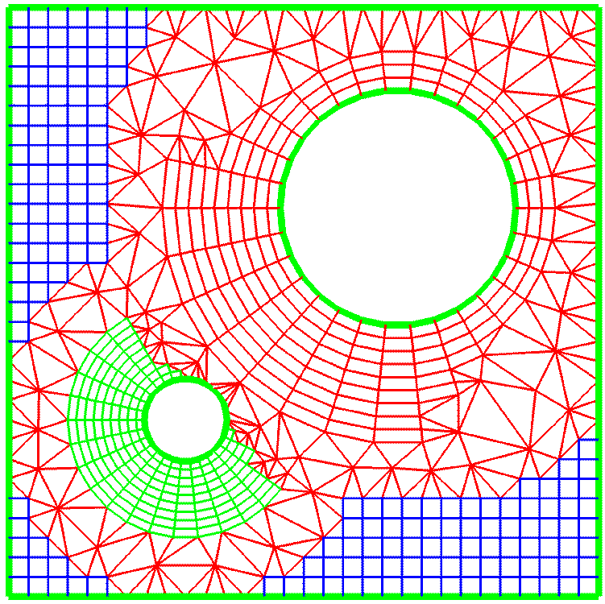
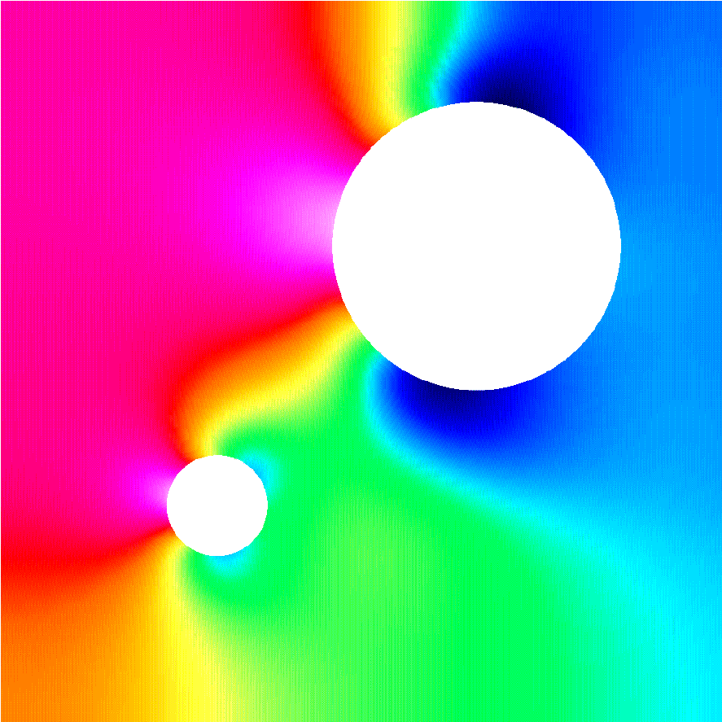
ITAPS Core Data Types abstract the PDE-simulation hierarchy.
Core Data Types:
Geometric Data: a high level description of the boundaries of the computational domain; e.g., CAD, image, or mesh data.
Mesh Data: the geometric and topological information associated with the discrete representation of the domain.
Field Data: the time dependent physics variables associated with application solution; e.g., scalars, vectors, tensors.
Data Relation Managers
Control the relationships among the core data types.
Resolve cross references between entities of different types.
Support applications that depend on multiple core data types.
Each core data type has an ITAPS interface.
Geometric data: iGeom – Field data: iField
Mesh data: iMesh – Relationship data: iRel

Slide 29
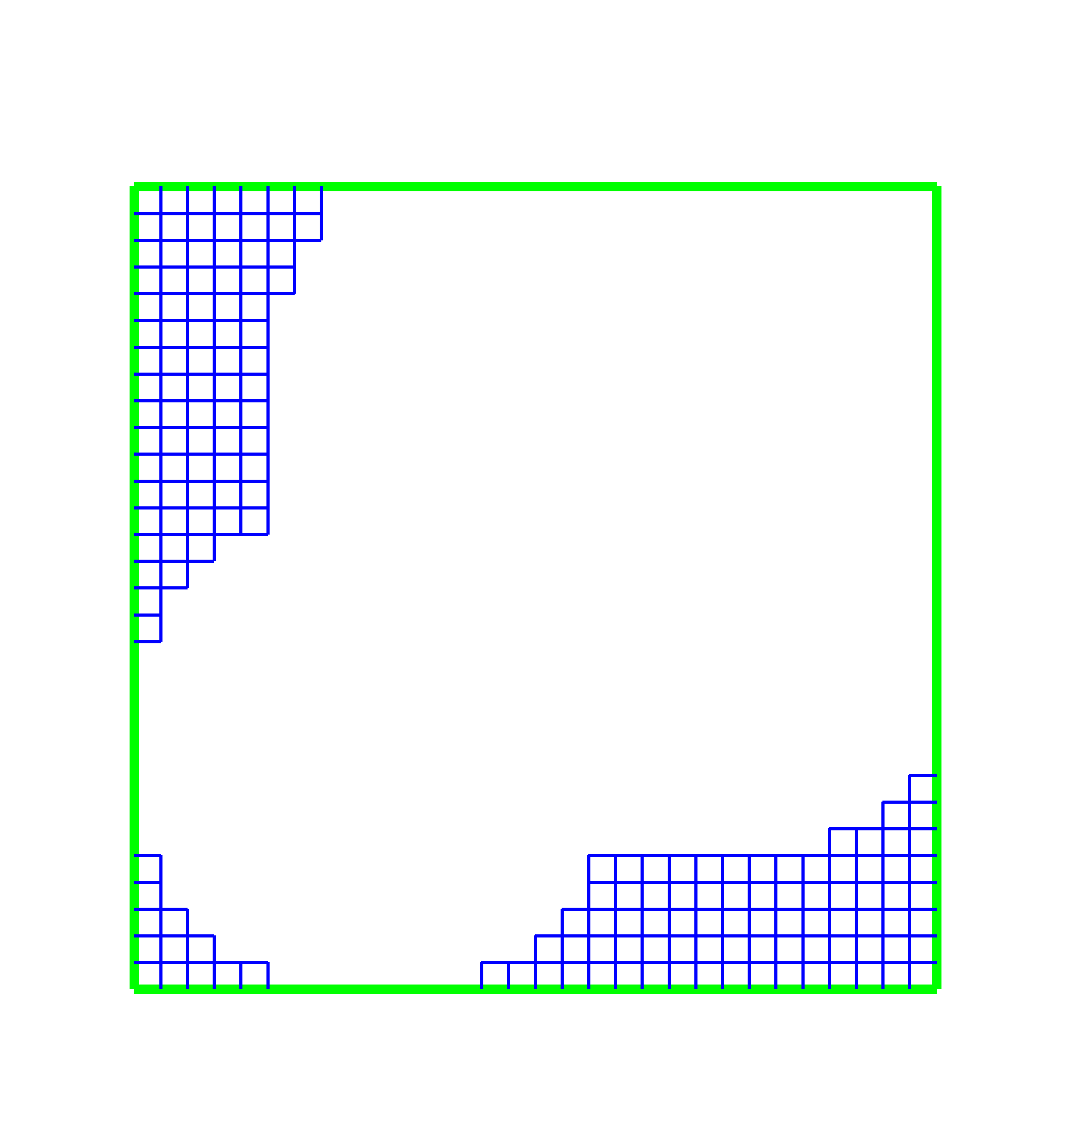
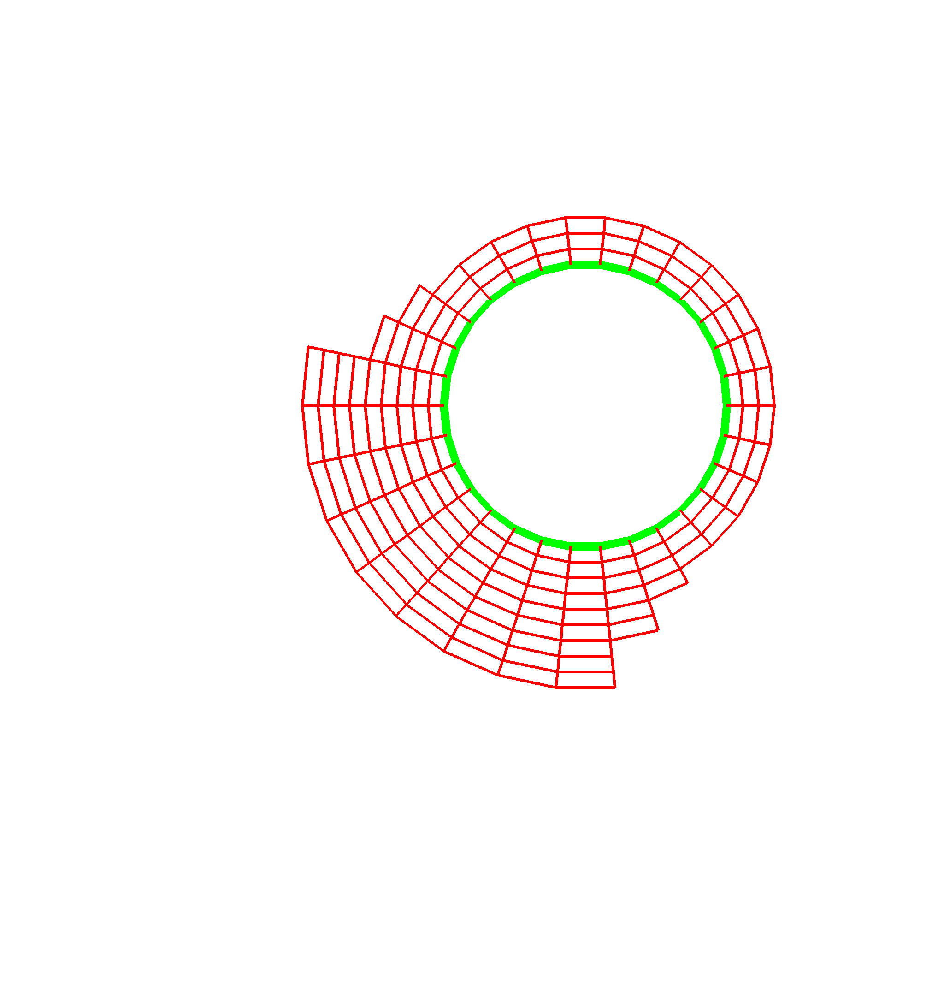

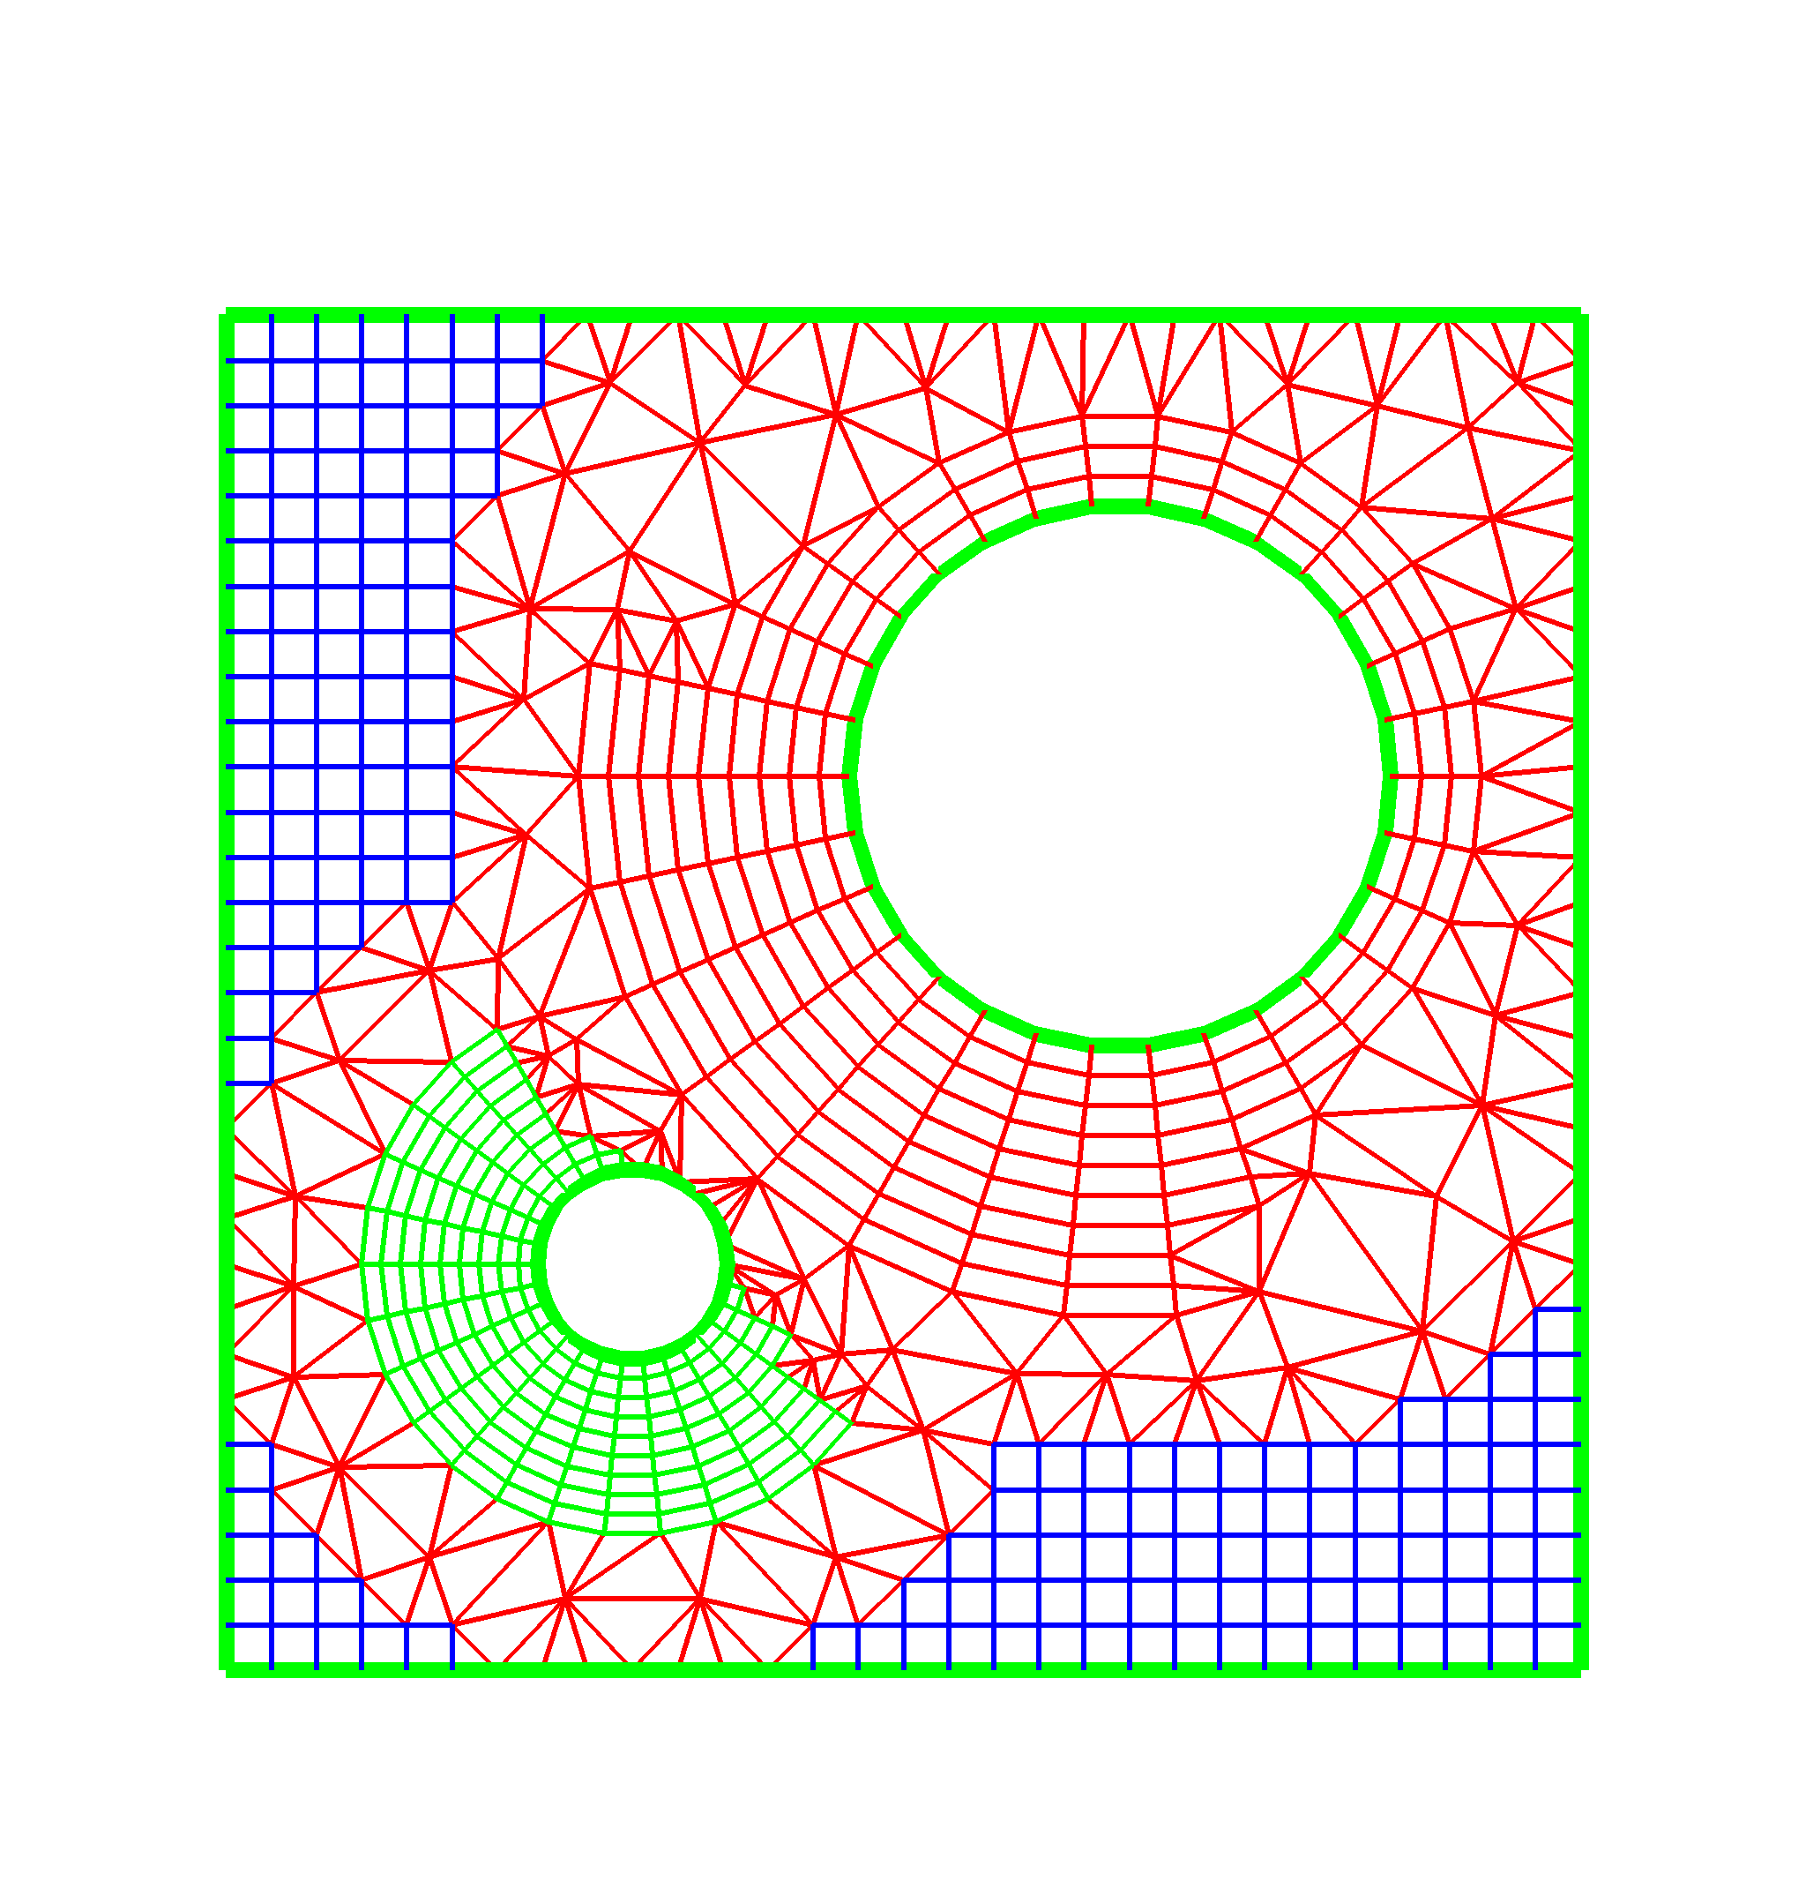
The ITAPS Data Model
The core data model blends abstraction with familiar mesh/geometry specifics.
Entities:
Fine-grained objects in mesh.
E.g., vertices, edges, faces, regions.
Entity Sets:
Arbitrary collection of entities and other sets.
Hierarchical relationships between sets.
Special “root” set contains all entities.
E.g., boundary conditions, materials.
Tags:
Associate user-defined data with entities and sets.

Slide 30
The iMesh interface supports basic and advanced local operations.
Access to vertex coordinates and adjacency information
Mesh loading and saving
Global information such as the root set, geometric dimension, number of entities of a given type or topology
Access to all entities in a set as single entities, arrays of entities, or entire set
Set/remove/access tag data
Set functionality
Boolean operations (union, subtract, intersect)
Hierarchical relationships
Mesh modification
Adding / Deleting entities
Vertex relocation
No validity checks

Slide 31
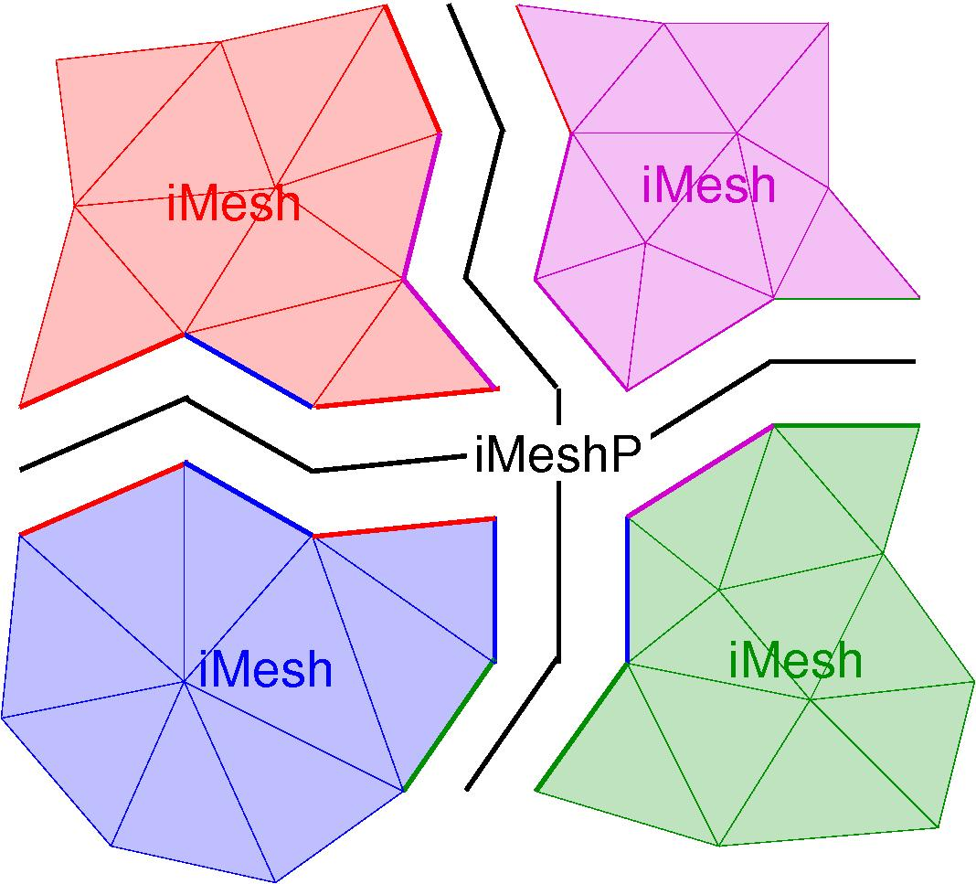
iMeshP extends iMesh to support parallel computations.
iMeshP: Interface to manage/query a mesh distributed across a parallel computer.
Simplifies the development of parallel mesh-based applications by managing the distribution of a mesh:
Load meshes onto parallel computers.
Maintain relationships between mesh entities on different parts.
Communicate tag data between parts.
Move mesh entities between parts and re-establish communication links.
Sufficient for building services such as:
Parallel mesh generation/improvement/modification
Partitioning and repartitioning

Slide 32
iMeshP supports common parallel programming paradigms.
Primarily support distributed memory.
For example: use MPI communicators from application.
But allow use of global address space and shared memory paradigms.
Maintain backward compatibility of serial iMesh.
Serial iMesh works as expected within a process.
Serial iMesh works as expected for global address space and shared memory programs.

Slide 33
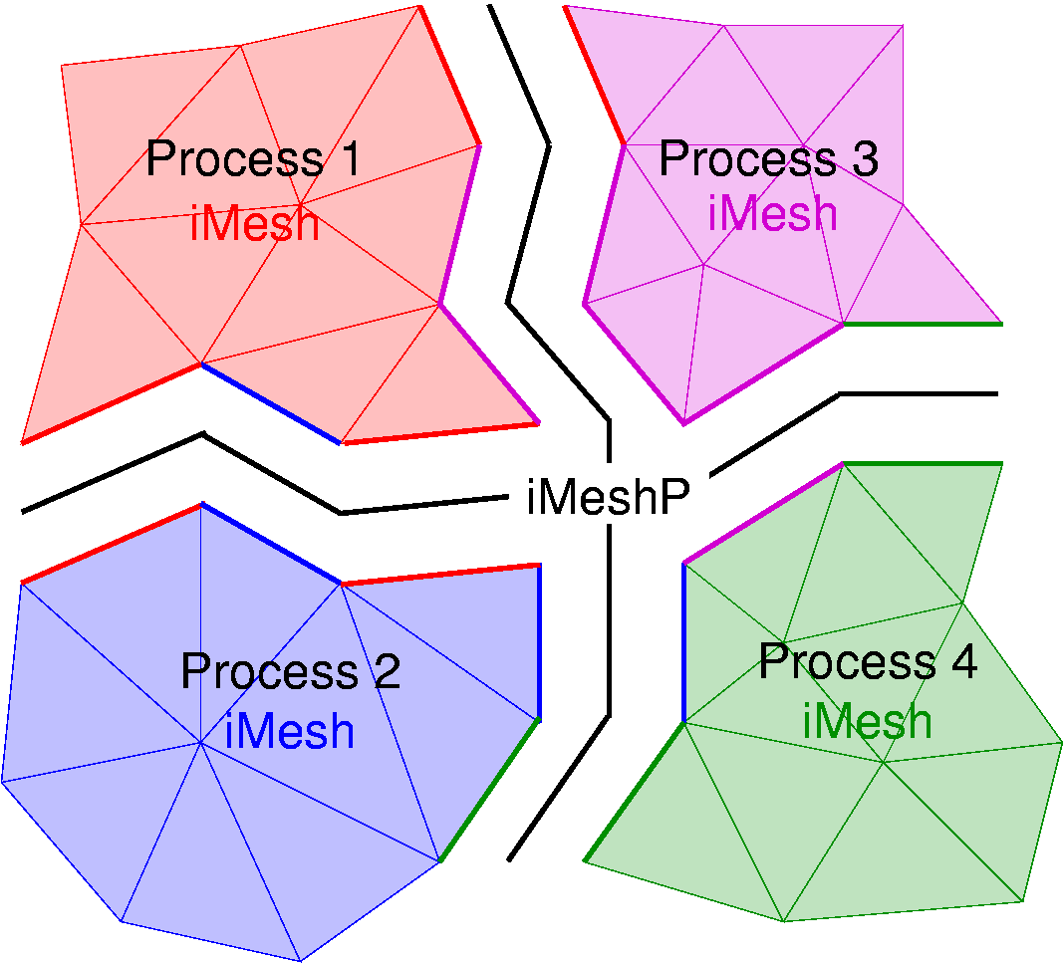
iMeshP includes a partition model of distributed meshes.
Process: a program executing; MPI process.
Number of processes == MPI_Comm_size
Process number == MPI_Comm_rank
iMesh instance: mesh database.
Typically one per process.
Manages all entities on process.
iMeshP partition: describes a distributed mesh.
Maps entities to subsets called parts.
Maps parts to processes.
Has a communicator associated with it.

Slide 34
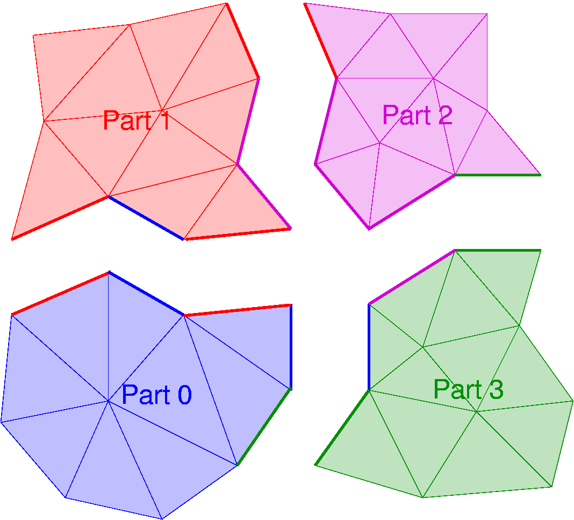
Parts contain subsets of entities on a process.
Parts are the units of concurrency.
Number of parts may be less than, equal to, or greater than number of processes.
Each part contains …
entities it owns AND
copies of entities needed for computation within the part.
A part is stored in a single process.

Slide 35
Partition Characteristics
Maps entities to parts
Part assignments computed with respect to a set of entities
Computed assignments induce part assignments for adjacent entities.
Maps parts to processes
Each process may have one or more parts.
Each part is wholly contained within a process.
Has a communicator associated with it
“Global” operations performed with respect to data in all parts in a partition’s communicator
“Local” operations performed with respect to either a part’s or process’ data

Slide 36
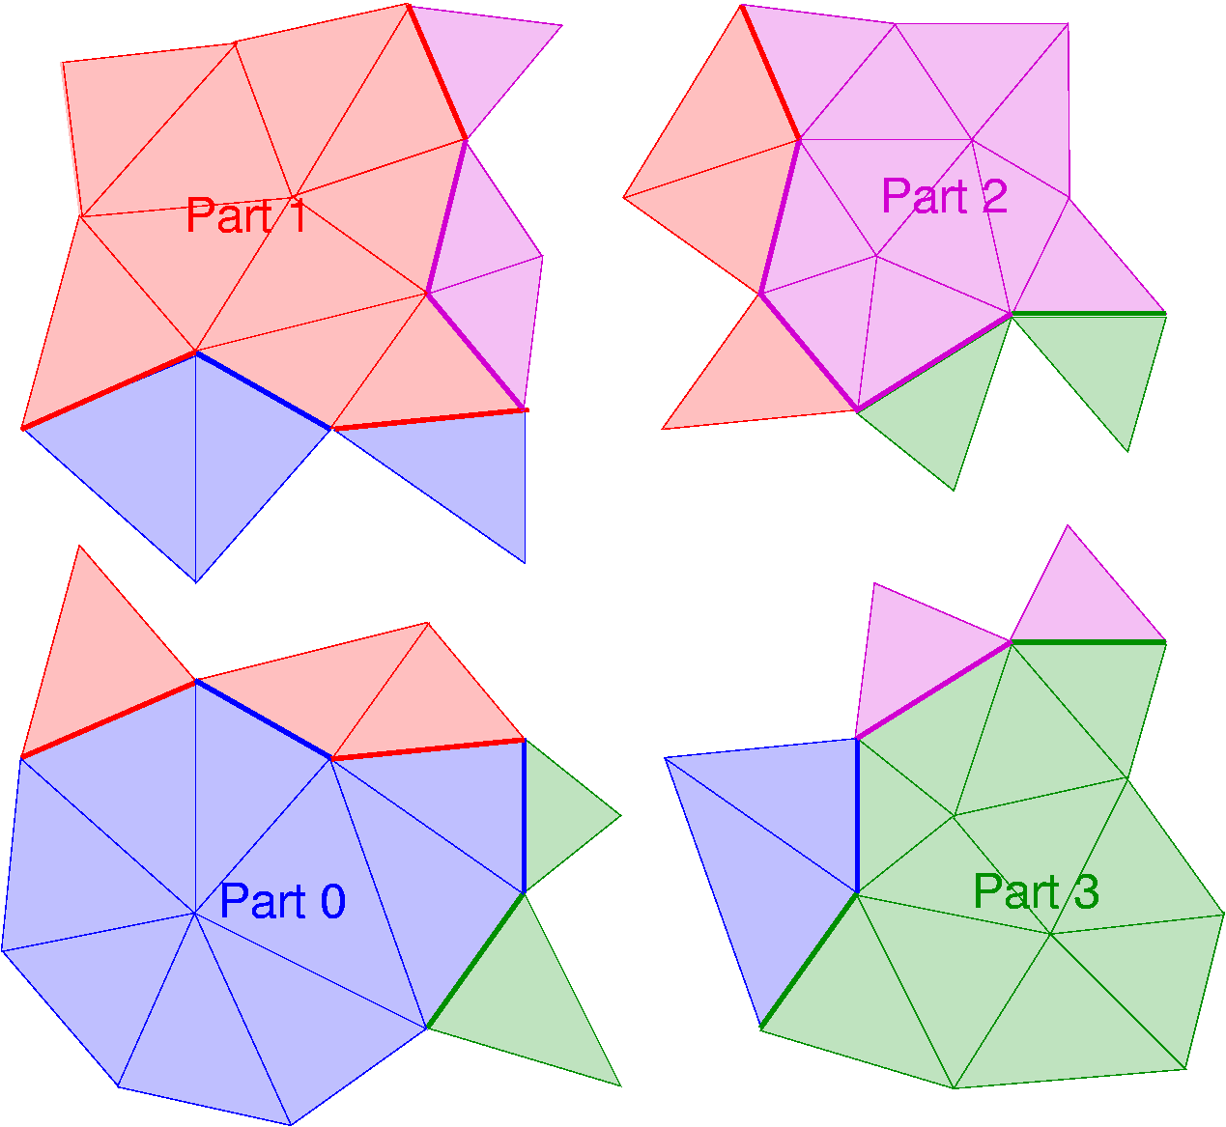
iMeshP manages entity ownership and entity copies.
Ownership: having the right to modify.
Internal entity: Owned entity not on an interpart boundary.
Part-Boundary entity: Entity on an interpart boundary.
Typically shared between parts (one part is owner; other parts have copies).
Owned
Copy
Part-boundary entities
Internal Entities
Ghost entities
Ghost entity: Non-owned, non-part-boundary entity in a part.
Copies: ghost entities + non-owned part-boundary entities.

Slide 37
Ghost Entities are created by simple rules.
Create ghost entities for each part.
Specify ghost-entity dimension, bridge dimension, and number of layers.
Cumulative over multiple calls.
Ghost rules are stored; ghosts are re-established after mesh modification.
One layer of ghost triangles for all boundary triangles sharing edges:
Ghost-entity dimension = 2
Bridge-entity dimension = 1
Number of layers = 1
1D Bridge entities
2D Ghost entities
1D Bridge entity

Slide 38
iMeshP supports inter-part mesh operations.
iMeshP provides functions for inter-part operations on mesh entities that require communication.
Both blocking and non-blocking operations are supported.
Blocking good when large amounts of data are sent.
Non-blocking important for mesh modification where small amounts of data are communicated.
iMeshP requests manage non-blocking operations.
Notes:
Blocking: large amounts of data at predictable synchronization points
Non-blocking: small amounts of data at unpredictable times.

Slide 39
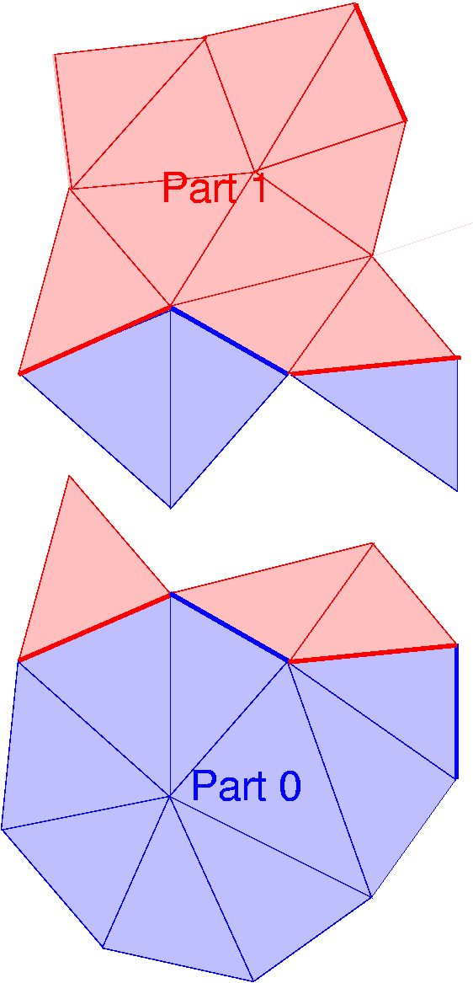
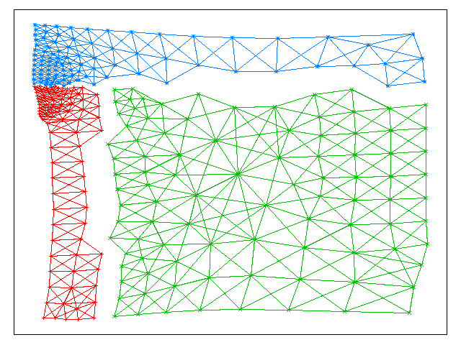
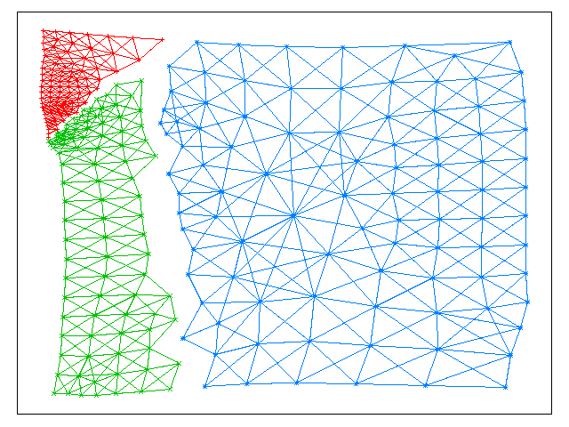
Large-scale inter-part mesh operations in iMeshP:
Ghost-entity updates of tag data from owners.
Integers, floats, strings, etc., associated with entities.
Migration of large number of entities to new parts.
Needed in partitioning and load balancing.

Slide 40
Inter-part mesh operations supporting mesh modification in iMeshP:
For edge splitting along part boundaries…
Both parts must coordinate handles for new edges and vertices.
E_{B1}
E_{R1}
E_{B}
E_{R}
E_{B2}
E_{R2}
For mesh smoothing...
Parts must be able to request changes to off-part vertex coordinates.
V
V
For edge swapping...
Migration of small numbers of entities is needed to collect needed entities in one processor.

Slide 41
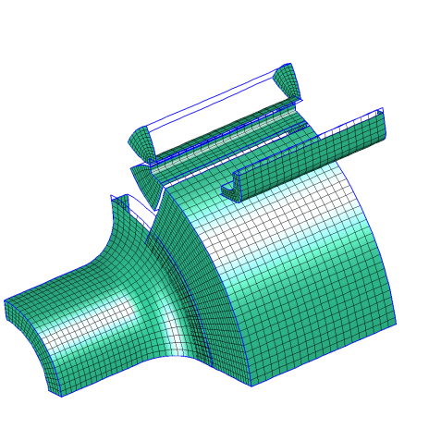
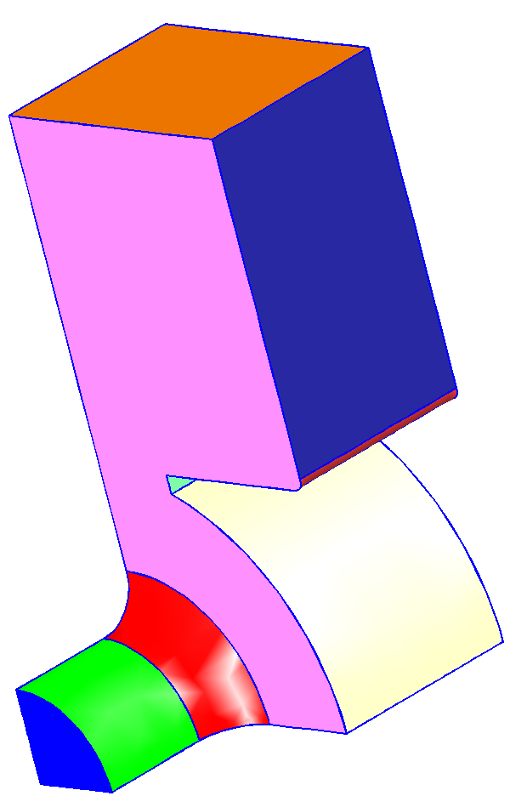
The iGeom interface provides access to the geometric domain.
Needed for…
automatic mesh generation
mesh adaptation
tracking domain changes
relating information between alternative discretizations
Supports various underlying representations
Commercial modelers (e.g., Parasolid, ACIS)
Open-source modelers (e.g., Open.CASCADE)
Modelers that operate from standard files (e.g. IGES, STEP)
Models constructed from an input mesh
Basic and Advanced Functionalities:
Model loading and initiation
Topological queries of entities and adjacencies
Pointwise geometric shape interrogation
Parametric coordinate systems
Model topology modification
Model construction (primitives, booleans)

Slide 42
iRel Relations interface enables other ITAPS interfaces to work together.
Relates entities between two interfaces without adding dependencies between them. E.g.,
Relate entities in iMesh to entities iGeom.
Generation of spectral element points on curved geometry.
Relationships supported:
Ent-Ent, Set-Set
Ent-Set, Set-Ent
Ent-Both
Both-Both
Entity
Entity
Entity
Set
Entity
Entity
Entity
Set
Set
Set
Set
Entity
Set
Set
Entity

Slide 43
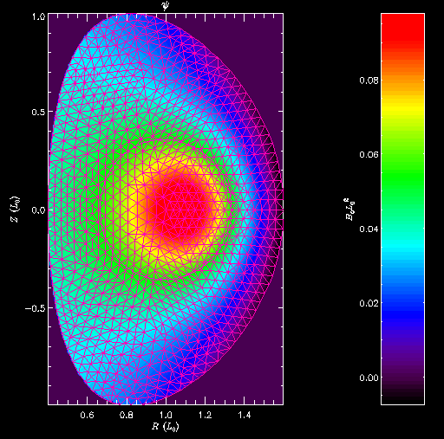
iField interface enables access to solution data.
Represent field as weighted sum of distribution functions
Key information:
SI Units, dimensions
Scalars, vectors, tensors, coordinates
Basis/distribution functions
Domains
Use cases:
Solution evaluation
Representation of analytic data
Mesh-to-mesh solution transfer
Change of basis
Interactions with solvers, preconditioners, post-processing tools.

Slide 44
Summary of the ITAPS data model
The data model abstracts the information flow in PDE simulations: Geometry, Mesh, Fields and their Relations.
Each core abstraction has a separate interface definition: iMesh, iGeom, iField, iRel.
The core building blocks of the data models are entities, entity sets, interfaces and tags.
The parallel data model defines partitions, parts, and entity ownership concepts.

Slide 46
ITAPS Parallel Mesh Technologies: Interfaces and Services

Slide 47
An overarching philosophy guides our interface definition efforts.
Create a small set of interfaces that existing packages can support
Should be able to implement the interfaces based on your representation of data structures
Allows incremental adoption
Keep interfaces for the different core data model abstractions separate
Balance performance and flexibility
Work with a large tool provider and application community to ensure applicability
Language Interoperability
C interface callable from C, C++ and Fortran
Use SIDL/Babel for Java and python support
Lowers the burden for adoption of the interface
Performance is critical for kernel computations involving mesh access; flexibility is critical for covering a broad usage spectrum

Slide 48
ITAPS Interface Design
app1.f77
app2.f90
app3.CC
app4.c
app4.py
iMesh (C)
PyTAPS
implA.CC
implB.c
implC.f77
Interoperability across language, application, implementation
C-based interface, but designed to be callable directly from Fortran and C++
Good portability, performance
Maintenance easier
iGeom, iRel too
Quick startup for new users

Slide 49
iMesh/iMeshP implementations represent discretized domains.
iMesh Implementation | Emphasis | Parallel Capability | Applications
FMDB: Flexible Mesh DataBase | Mesh addition/removal for adaptation | Scalable to 288K procs, 9B elements; uses iZoltan. | fusion, accelerators, CFD, solid mechanics, multiphase flow
MOAB: Mesh Oriented dAtaBase | Low memory usage first, then CPU time. | Up to 16K procs with flexible mesh loading based on geometric volume, material, partition | nuclear reactors, accelerators, radiation transport, inertial confinement fusion, glacier dynamics
GRUMMP: Generation & Refinement of Mixed-element Meshes in Parallel | Fast adjacency retrieval for mesh generation, improvement and adaptation. | In development. | CFD, biological systems, structural mechanics
NWGrid: NorthWest Grid Generation Code | Simplicial meshes; parallel generation of unstructured, hybrid, adaptive meshes. | Parallelism based on Global Arrays. | CFD, subsurface transport

Slide 50
iGeom implementations provide geometric model data.
iGeom Implementation | Capabilities | Applications
CGM: Common Geometry Module | Supports ACIS, Open.Cascade, facet-based engines; Derived from geometry library in CUBIT. | nuclear reactor modeling, accelerator modeling, radiation transport
GMI: Geometric Model Interface (SCOREC) | Supports CAD system kernels (ParaSolid, ACIS) and mesh-based geometry. | MeshAdapt service, accelerator modeling, fusion, solid mechanics, multiphase flow.

Slide 51
iRel Relations interface enables other ITAPS interfaces to work together.
Relates entities between two interfaces without adding dependencies between them. E.g.,
Relate entities in iMesh to entities iGeom.
Generation of spectral element points on curved geometry.
Relationships supported:
Implementations available in Lasso (ANL), GRM (RPI).
Ent-Ent, Set-Set
Ent-Set, Set-Ent
Ent-Both
Both-Both
Entity
Entity
Entity
Set
Entity
Entity
Entity
Set
Set
Set
Set
Entity
Set
Set
Entity

Slide 52
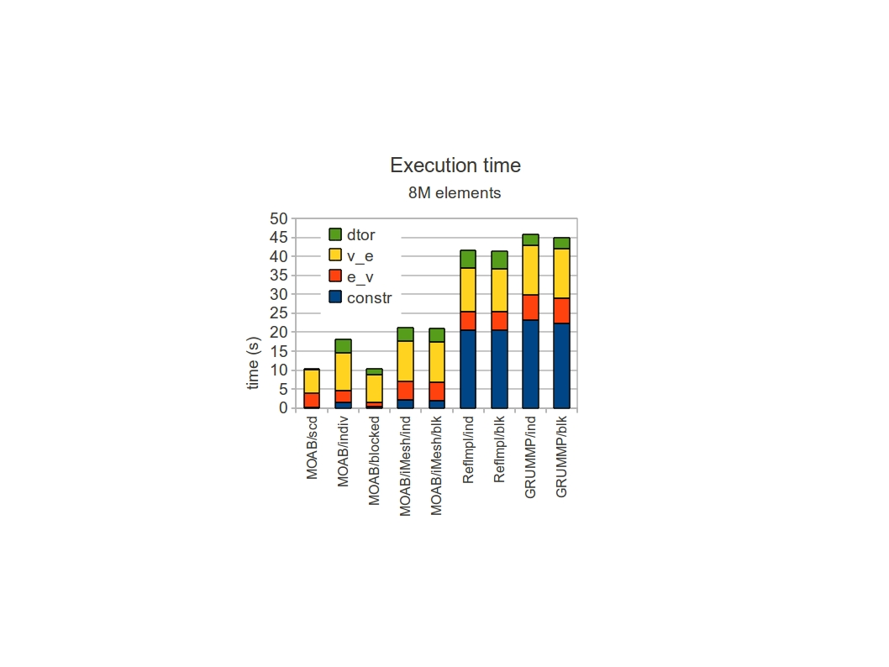
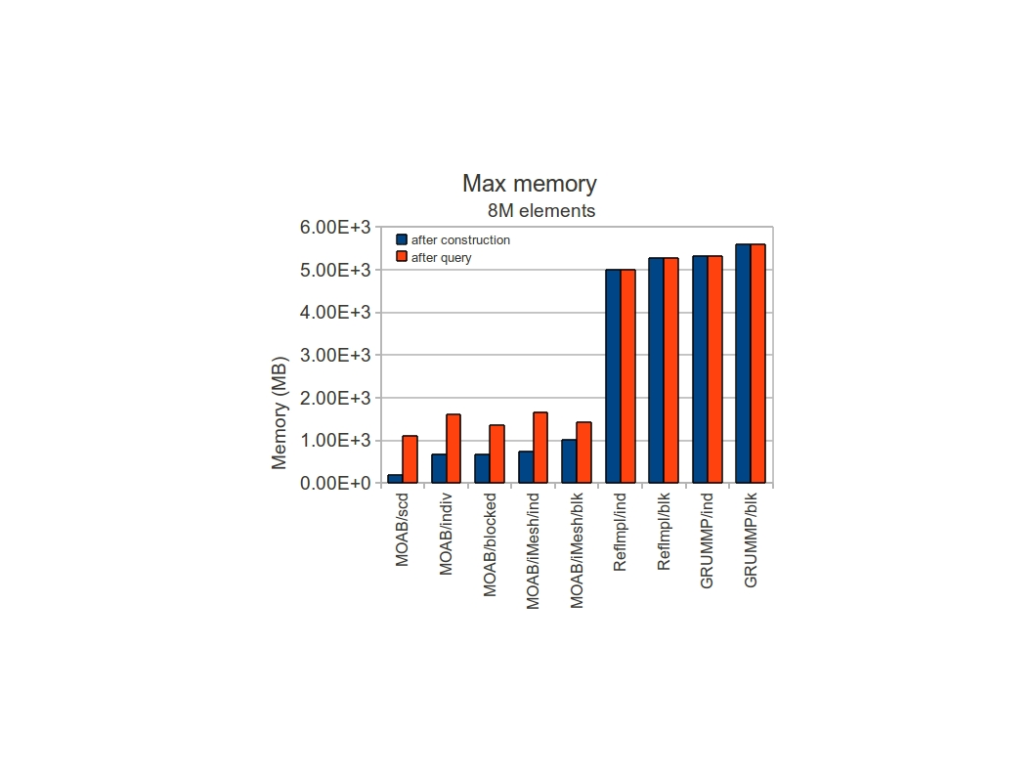
Performance depends on use case Hex mesh create, evaluate, destroy
Create structured NxNxN hex mesh, evaluate hex-vertex, vertex-hex adjacencies, destroy mesh
Tested per-entity vs. whole-mesh access, on MOAB, MOAB/iMesh, RefImpl
MOAB blocked creation, access particularly efficient
MOAB Range data structure makes a difference during construction
After query, memory increases, due to adjacency storage
Less relative iMesh overhead after query

Slide 53
Performance depends on use case Mesh swapping
Mesh swapping: MANY calls to region-face, face-region, cell-vert, face-vert adjacencies
Create/delete also called often
Performance:
MOAB/iMesh: 939 swaps/sec
RefImpl/iMesh: 19050 swaps/sec
GRUMMP/iMesh: 18950 swaps/sec
GRUMMP/Native: 25100 swaps/sec

Slide 54
Performance in building a finite element stiffness matrix
Set up a simple stiffness matrix for a 2D diffusion equation
Examine costs of entity access via native data structures, arrays, entity iterators and workset iterators
Arrays minimize time overhead but require a data copy
Entity iterators are straightforward to program, minimize memory overhead, but maximize time cost
Entity array iterators balance time/memory tradeoffs but are the most difficult to program
∇²u = f
u(x=0)=1 u(x=1) = 1
u_{y}(x=0, x=1) = 0

Slide 55
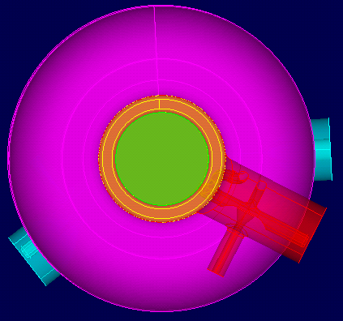
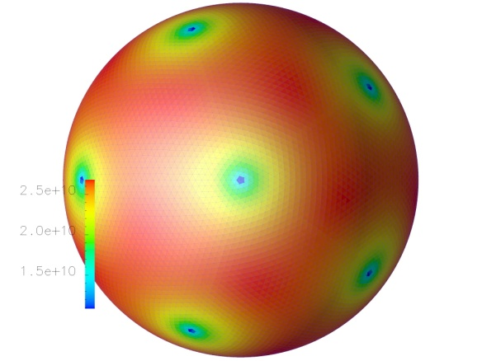
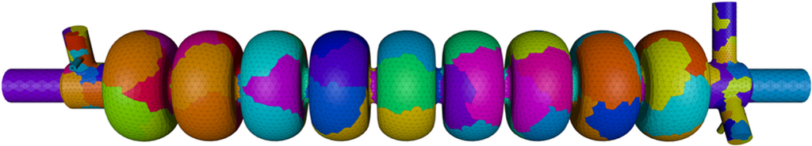

ITAPS Services interoperate through the interfaces.
CAD interaction: CGM, GMI
Mesh generation: GRUMMP, NWGrid, MeshKit
Mesh databases: FMDB, GRUMMP, MOAB
Mesh improvement: Mesquite, swapping tools
Parallel Adaptive loops: FMDB, NWGrid, MeshAdapt
Front tracking: Frontier
Partitioning: Zoltan
Visualization and I/O: VisIt, EyeMesh, MeshI/O

Slide 56



ITAPS Services: Mesh Quality Improvement
In general, mesh size and quality affects
Solution efficiency (e.g. Axelsson, 1976; Fried 1972; Axelsson and Barker, 1984)
Iterations grow as a function of N
Iterations grow as a function of minimum angle
Solution accuracy
Solution from iterative solver is less accurate
For isotropic fields, discretization error adversely affected by distorted elements (e.g. Babuska and Aziz, 1976)
Understanding application solution characteristics is critical.
Stretched elements are more accurate than equilateral elements for boundary layer flow.
Improved
mesh

Slide 57
There are three primary techniques for improving the quality of existing meshes.
Node Movement
Edge or Face Flipping
Refinement/Coarsening
f
f
e
e
f
e
Moving grid points without
changing mesh topology
Modify topology without changing
grid point location
Adding or deleting elements to improve local resolution

Slide 58


Mesquite provides advanced mesh smoothing capabilities.
Mesquite is a comprehensive, stand-alone library for mesh quality improvement with the following capabilities
Shape Quality Improvement
Mesh Untangling
Alignment with Scalar or Vector Fields
R-type adaptivity to solution features or error estimates
Uses node point repositioning schemes
Parallel to O(1000) processors
Tested with FMDB, MOAB, NWGrid, GRUMMP iMesh implementations

Slide 59
Parallel smoothing requires special attention at partition boundaries.
Incorrect execution of the smoothing algorithm can occur unless partition boundaries maintain consistent updates of vertex locations; requires synchronization with partition neighbors.
P1
P2
free vertices
fixed vertices

Slide 60

Swapping complements node point movement in improving mesh quality.
Changing topology can eliminate poorly-shaped mesh entities directly.
Service using standard interface handles error-prone aspects of implementation.
Swapping decisions
Topological changes to the mesh
Swapping service functionality
Triangular/tetrahedral edge and face swapping
Works on single entities, mesh subsets, or entire mesh
Built in and user-defined swapping criteria provide both ease of use and flexibility
Tested with FMDB, MOAB, and GRUMMP
Notes:
Yes, the performance is a little sad, but still faster than trying to write your own from scratch, and get it all right. :-)‏

Slide 61


Issues with swapping in parallel
Must migrate data onto single processor to modify
Load balance and communication overhead issues

Slide 62


ITAPS Services: Mesh Adaptation
Determining optimal initial mesh sizes is not possible for complex geometry/ physics.
CFD adaptivity example impact:
Isotropic : same accuracy as uniform with one order of magnitude fewer elements
Anisotropic : same accuracy as uniform with two orders of magnitude fewer elements
MeshAdapt Service
Starts with an arbitrary initial mesh with a solution
Given a new mesh size field, alters the mesh via local mesh modifications
Supports
Curved Boundaries
Anisotropy
Parallel mesh adaptation

Slide 63


Scaling studies of uniform refinement on up to 32K processors
Weak scaling uniform refinement
Mesh adaptation is characterized by small, but variable, work per operation - “perfect scaling” too costly.
Can run on the large numbers of parts used in the analysis
Will still be a small % of total solution time - the mesh adapt example given is 0.04% of the estimated solve time
Improvements to message passing can improve scaling.
# of Parts | Initial Mesh | Adapted Mesh | Time (s) | Scaling Factor
2048 | 17M | 128M | 5.0 | 1.0
4096 | 34M | 274M | 4.8 | 1.05
8192 | 65M | 520M | 5.1 | 0.97
16384 | 520M | 1.1B | 6.1 | 0.82
32768 | 274M | 2.2B | 7.4 | 0.68

Slide 64


ITAPS Services: Load Balancing
iZoltan service using the Zoltan load-balancing library
Partitioning Methods
Geometric (RCB, Space filling curves)
Connectivity-based (Graph, Hypergraph, ParMetis, Scotch)
iMesh and iMeshP versions available
Tested and adopted by FMDB, GRUMMP, MOAB, MeshAdapt, accelerator and fusion scientists

Slide 65


MeshAdapt and iZoltan used to prepare strong scaling study on 128K processors
PHASTA CFD solver
Implicit time integration - iterative system solution at each time step
Employs the partitioned mesh for system formulation and solution
PHASTA’s work characterized as:
Organized and regular communication between parts that “touch” each other
A specific number of ALL-REDUCE communications also required
ITAPS Services used
FMDB for the mesh database
MeshAdapt for refinement up to 32K
iZoltan to partition the mesh to 128K
1 billion element anisotropic mesh on Intrepid Blue Gene/P
#of cores | Rgn imb | Vtx imb | Time (s) | Scaling
16k | 2.03% | 7.13% | 222.03 | 1
32k | 1.72% | 8.11% | 112.43 | 0.987
64k | 1.6% | 11.18% | 57.09 | 0.972
128k | 5.49% | 17.85% | 31.35 | 0.885

Slide 66


ITAPS Services: Front-tracking
FronTier front-tracking library
Intended uses include
Computational domains sharply different quantitatively or qualitatively, boundary dynamic
Tracking the dynamic motion of distinct bodies, or interfaces between distinct physical regions
Coupled with hyperbolic, parabolic, and elliptic PDE solvers
Parallel to 16K processors
Applications: fluid-fluid, fluid-structure, crystal growth, phase transition, elastic-plastic, and other moving interfaces
Available and tested with the iMesh interfaces through FMDB, MOAB, and GRUMMP
FronTier meshed data structure
b

Slide 67




ITAPS Services: Visualization
VisIt database plug-in
A single plug-in supports multiple ITAPS implementations.
Supports all entity types, set and tag data through iMesh
Prototype parallel service demonstrated with iMeshP and FMDB
Future integration will use VisIt’s in-situ ‘simulation’ interface for run-time visualization.

Slide 68


ITAPS Services: Interoperable Mesh I/O
MeshI/O service provides access to a wide array of scientific data through VisIt readers.
100+ different file formats
Instantiated into any iMesh implementation
Supports all mesh topology and geometries, and fields stored as dense tags
Demonstrated ability to instantiate data from previously unsupported file type and partition it via iZoltan through iMesh

Slide 69
Implementing ITAPS interfaces allows use of services on your data structures
Need to implement some ITAPS interface functions using your data structures – BUT NOT ALL
Most ITAPS functions reflect things you already do with your databases; most implementation tasks are a thin wrapper
Compliance testing tools ensure correctness
Can use a reference implementation at the cost of a data copy to experiment with services
Component
Service 3
Application w/
Own Data
High Level
Integrated Service
Component
Service 2
Interface
Component
Service 1

Slide 70
Interface functions needed by the various services

Slide 71
Or applications may use one of the ITAPS reference implementations.
Use a reference implementation of the interfaces to provide access to ITAPS services at the cost of a data copy
Component
Service 3
Application using
ITAPS Implementation
High Level
Integrated Service
Component
Service 2
Interface
ITAPS Implementation
Successful development of applications has been accelerated by close collaboration.

Slide 72

Download implementations and services at ITAPS web pages.
http://www.itaps-scidac.org
Provides help getting started
Usage strategies
Data model description
Access to interface specifications, documentation, implementations
Access to compatible services software

Slide 73
ITAPS Software: Best Practices
Use C-based interface where possible, for efficiency.
Pre-allocate memory in application or re-use memory allocated by implementation.
E.g. getting vertices adjacent to element – can use static array, or application-native storage
Take advantage of implementation-provided capabilities and iMesh compliant services.
Partitioning, IO, parallel communication, (parallel) file readers
Try different implementations: they are tuned for different application uses – Experiment!
Implement iMesh on top of your data structure.
Take advantage of tools that work on iMesh API.
Let us help you.
Not all best practices are easily described or self-evident.

Slide 74
Applications using ITAPS Tools

Slide 75


Parallel Tet Mesh Generation
Approach:
Partition geometric model surfaces and volumes over processors
Mesh interface surfaces & communicate
Mesh non-interface surfaces
Mesh volume interior
Save mesh
Accelerator cavity model
228 bodies
11.6M element mesh
Speedup: max 25 on 40 procs
Notes:
Longer term challenges: There are things harder that parallel adaptive. Parallel meshing is one of them.

Slide 76
Mesh Curving for SLAC Accelerator Simulations
Reliably produces valid meshes from invalid curved elements.
Valid meshes allow solution to run and produce results that can be used.
Simulations also ran 30% faster due to better conditioning.
Example:
2.97 millions curved regions in input mesh
1,583 invalid curved elements
All corrected by mesh curving tool using curved mesh modification operations
Edge collapse | 253
Region collapse | 17
Edge swap | 76
Double edge split+collapse | 13
Recurving | 32

Slide 77




Curved Ansiotropic Meshes in Thin Regions
Close-up of curved anisotropic mesh
CAD Model
Thin sections identified and meshed
Final curved anisotropic mesh

Slide 78




Mesh Adaptation for SLAC Wakefield Calculations
Adaptively refined meshes have 1~1.5 million curved regions
Reduced the number of elements needed by nearly an order of magnitude
Best Meshing Technical Poster Award,17th International Meshing Roundtable - X. Luo.
M. Shephard, L.-Q. Lee, C. Ng, L. Ge, “Tracking Adaptive Mesh Refinement in 3D
Curved Domains for Large-Scale Higher-Order Finite-Element Simulations”
Electric fields on the three refined curved meshes

Slide 79




Shape Optimization for Accelerator Modeling
ILC cavity, with HOM couplers
Variety of tools
Geometry construction
Geometry-mesh association
Mesh smoothing
Optimizer
Design sensitivities using FD
High-fidelity geometry
Large mesh
Interoperability between components, in-situ
Geometry/mesh support:
Ddriv
Iteration 0:
Omega3P,
Sensitivity,
Optimization
p₀
Ddriv
G(p₀)‏
CUBIT
m(p₀)‏
Iteration 1..k:
p_{k}
Ddriv
G(p_{k})‏
Ddriv
m₀’
…

Slide 80



Anisotropic mesh adaption in M3D-C1 MHD code at PPPL
Support of anisotropic mesh adaptation
Compute size field
Hessian interpolation or a priori known vorticity mode
Apply high order local solution field transfer together with the mesh adaptation
Initial mesh and vorticity field Computed size field Adapted mesh and transferred field

Slide 81






Reactor Simulation Application
SHARP framework
Couple multiple physics modules (T/H, neutronics, etc.)‏
Data substrate uses ITAPS interfaces, components, services
Advanced meshing tools
7-pin non-conformal hex mesh
ARR 1/6 core generated with copy/move/merge
Fuel assembly, 1/6 core model, Advanced Recycle Reactor

Slide 82



Reactor Geometry/Mesh Generation
Script-based tool for specifying 2-level lattice
Assemblies: lattice of fuel/control rods
Core: lattice of assemblies
RGG suite of tools generate geometry/mesh in 3 phases
AssyGen: generate assembly geometry, mesh journal file
Cubit: generate assembly mesh
CoreGen: read/copy/move assembly meshes into core lattice
Tautges & Jain, “Creating Geometry and Mesh Models for Nuclear Reactor Core Geometries Using a Lattice Hierarchy-Based Approach”, 19th IMR, Wed 6B
Very High Temperature Reactor (VHTR) 1/6 core model & detail

Slide 83




Solution Transfer Service
Source:
12k hex mesh
Arbitrary scalar field
Target:
130k tet mesh
Distributed over same procs
Linear interpolation onto target vertices

Slide 84



Embedded Boundary Mesh Generation
Cut-cell or Embedded Boundary meshes used in various applications
Use hierarchical Oriented Bounding Box tree for fast ray-tracing on faceted geometric model
Ray-surface intersections determine inside/bdy/outside cells
Reduces execution time from O(logN_{t}N³) to O(logN_{t}N²)
Kim, Tautges, “EBMesh: An Embedded Boundary Meshing Tool”, 19th IMR session 4A

Slide 85




Front Tracking in DOE energy related research
Study of subsurface solute precipitation
In collaboration with PNNL
Simulation of bio-fuel jet for
efficient and renewable energy
Collaborated with ORNL etc
Front Tracking simulation of pellet
Ablation, we focus on detailed ablation
physics, ablation rates etc. By Roman
Samulyak et al at BNL in collaboration
with General Atomic

Slide 86




Other Front Tracking applications
Acceleration driven fluid interface instabilities
Supernova explosion
Shock-bubble interaction
Simulation of supernova
Explosion By Tulin Kaman
Simulation
Of cell
motion
Rayleigh-Taylor Mixing

Slide 87





Geometry & Mesh for Ice Sheet Modeling
Ice sheet bed location derived from remote sensing data represented as point set, elevations
Need:
All-quad, all-hex mesh for ice sheet bed/ice sheet
Smooth normal field, for slip boundary condition modeling
Ice sheet geometry, mesh capability assembled from combination of ITAPS and non-ITAPS tools
Jakobshavn glacier, Greenland
Original (Triangle/MOAB): 5M tri
Decimated (Qslim/MOAB): 20k tri
1km quad mesh (CAMAL/MeshKit/MOAB)

Slide 88
Conclusion

Slide 89
What you learned today
Mesh management in distributed memory simulations requires a richer data model to represent parallelism.
A broad range of component-based parallel mesh technologies are available for use in applications and research.
The ITAPS interfaces provide an avenue to leverage these technologies with incremental adoption.

Slide 90
Future Efforts in ITAPS
Scalable support for emerging architectures.
Multicore systems with threading
Exascale systems
Accelerators
Continued mesh-based research
Solution transfer
Parallel mesh generation
Improved mesh curving
Mesh-based partitioning models
Greater adoption of ITAPS interfaces

Slide 91
None of this would be possible without a strong team of contributors
We thank all those who have contributed to the ITAPS interface definition effort and software!
ANL: Tim Tautges, Iulian Grindeanu, Rajeev Jain, Dmitry Karpeev, Hong-Jun Kim, Bob Smith
LLNL: Lori Diachin, Mark Miller, Kyle Chand, Martin Isenburg
PNNL: Harold Trease
RPI: Mark Shephard, Ken Jansen, Seegyoung Seol, Xiao-juan Luo, Ting Xie, Onkar Sahni
SNL: Vitus Leung, Karen Devine, Pat Knupp
SUNY SB: Xiaolin Li, Brian Fix, Ryan Kaufman
UBC: Carl Ollivier-Gooch
U Wisconsin: Jane Hu, Jason Kraftcheck, Jim Porter

Slide 92
Contact Information
ITAPS Web Page:
http://www.itaps.org
ITAPS Software Page:
http://www.itaps.org/software
Email:
itaps-mgnt@llnl.gov

